Slide 1
OCAS: An online CAR AUCTIONING SYSTEM TO AID COMPTENCY IN AUCTIONING AND BIDDING OF CARS NAME: BWALLEY NICHOLAS STDNO: 122790 SUPERVISOR: JOSEPH MUNGAI

Slide 2
PROBLEM STATEMENT
Recently car transportation from one place to another was done mostly through means of road and railway. Auctioning in the current manual system was carried out at a specific location at times far from the auctioneers place whereby people would agree where they want the auction site to be at a certain place. So the auctioneer used to spend extra charges to transport their goods to the auction site and sometimes return with them without getting a suitable bidder. In addition, the owner sometimes used to hire a broker to help him sell a car at a certain commission rate.
However the broker used to hike the price higher than the given auction price to get a higher profit plus the benefit of still getting the commission price agreed.
Therefore problem experienced in the current manual system is over-exaggerated car prices set by the car brokers’ given the tender to auction cars to potential buyers.
The Over-exaggerated car prices makes the potential buyers not to buy the car because the price set is not directly proportional to the car they are promised by the brokers.

Slide 3
LITERATURE REVIEW
2.1 Introduction
2.2 Auctioning process in Kenya
2.2.1 Challenges Faced by Auctioneers in Kenya
2.3 Related Works
2.3.1 E-Bay
2.3.2 Auto Auction Mall
2.3.3 Salvage Bid
2.4 Gaps of the Existing System
2.5 Conceptual Framework

Slide 4
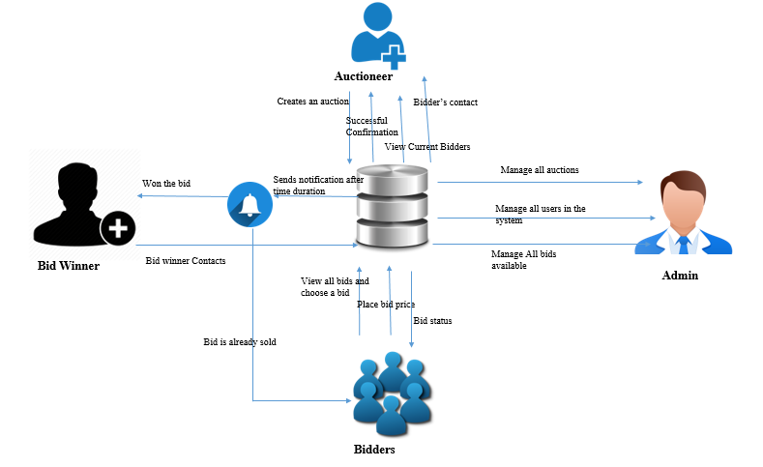

Slide 5
Chapter 3: Methodology
3.1 Introduction
System methodology OOAD(Capturing real-world object in current scenario of importance to the system. Data Structures as Opposed to the procedural structure. Objects are identified and their relationship between each other.
3.2 System Development Approach
Modified waterfall methodology (sequentially implemented) (stages)
3.3 System Analysis
Objectives of S.A is to find out what is being done, how to do, and how it can be improved.
3.3.1 Use-case
3.3.2 System sequence
3.3.3 Class Diagram
3.3.4 Tools and Techniques to be Applied
-HTML, CSS, PHP, MYSQL
3.4 System Design
3.4.1 Database Schema
3.4.2 ERD
3.5 System Deliverables and Milestones
Clients
Admin

Slide 6
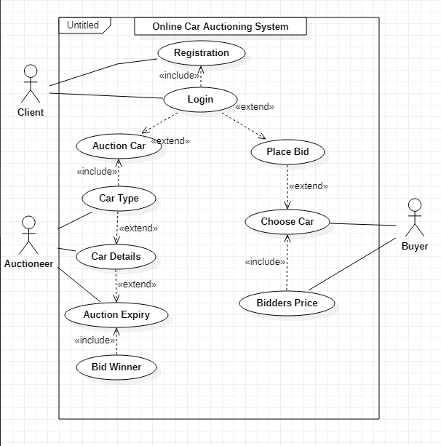
USE-CASE DIAGRAM

Slide 7
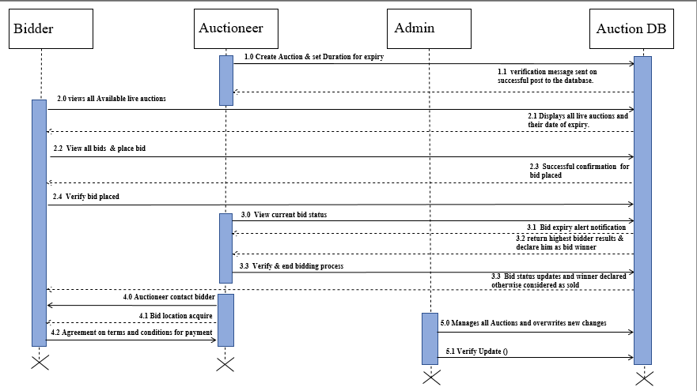
SEQUENCE DIAGRAM

Slide 8
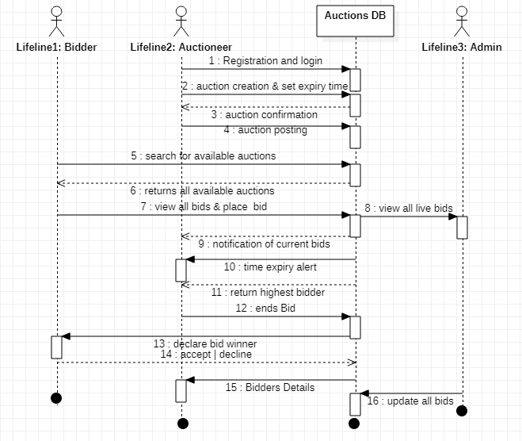
SYSTEM SEQUENCE DIAGRRAM

Slide 9
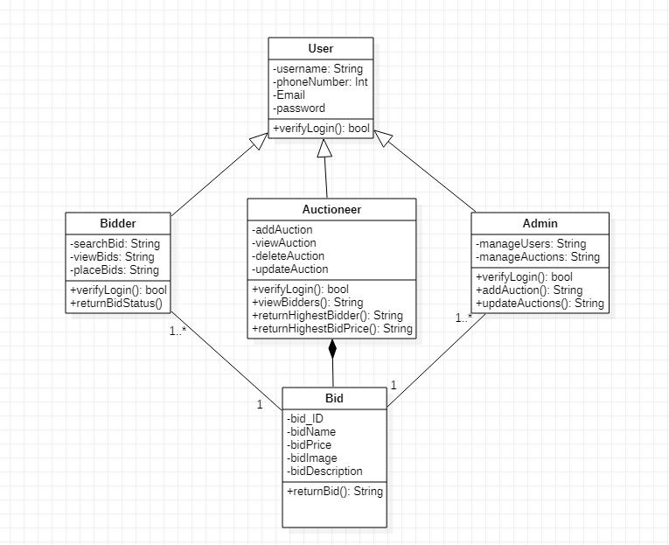
CLASS DIAGRAM

Slide 10
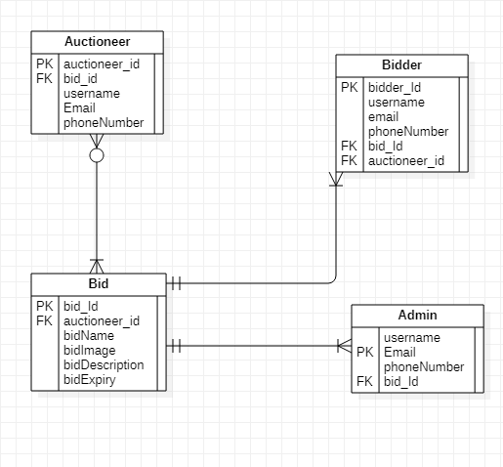
ENTITY RELATIONSHIP DIAGRAM

Slide 11
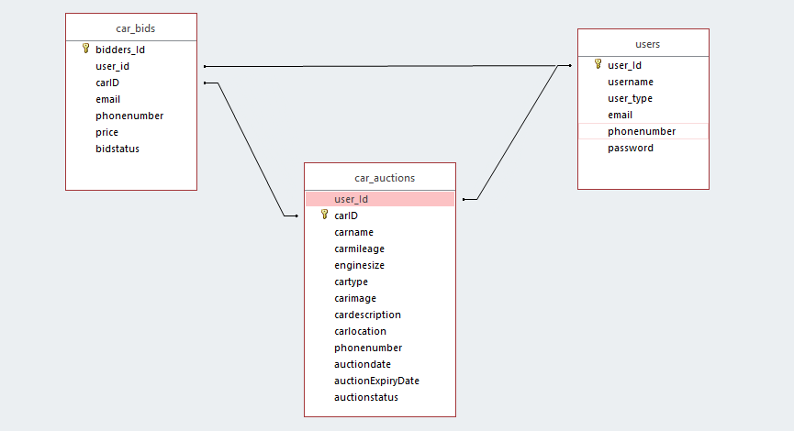
DATABASE SCHEMA

Slide 12
THANK YOU!...
NOW WE GO TO THE SYSTEM DEMO!...

